Slide 1
Pop Culture References:
-Research background (describe what it is, what it means)
-Illustrate your research with photos, drawings to show it.
-Provide Context: how it is used in the chapter or novel, include a quotation and page number
-Purpose? Explain the key ideas by showing relevance to the novel so far?

Slide 2
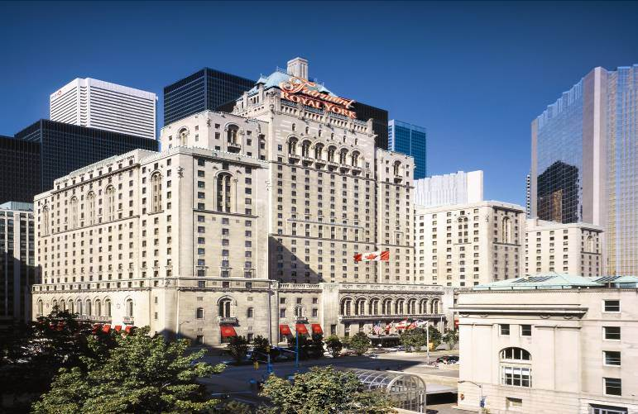
The Fairmount Royal York Hotel

Slide 3
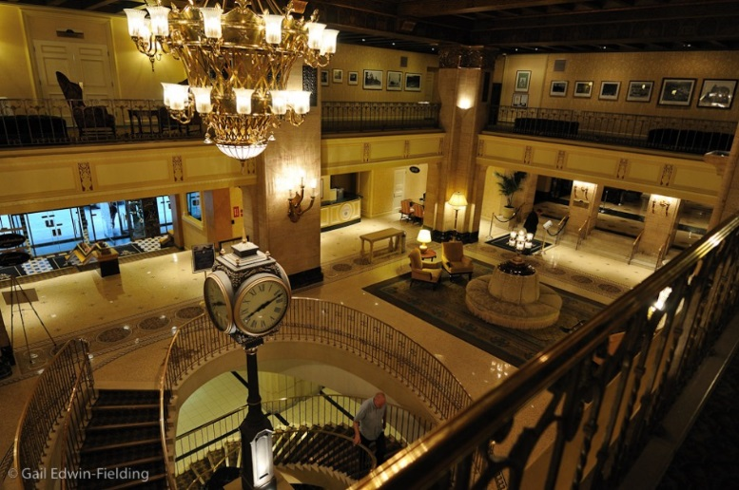
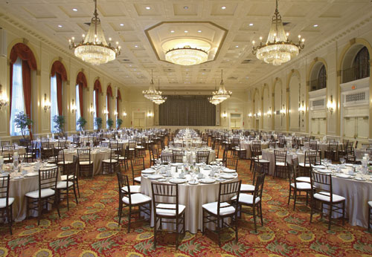
This site has gone through nearly half a dozen name changes and shifts in ownership starting in 1843. The building we know today came to be when the Canadian Pacific Railway announced it would build the largest hotel in the British Commonwealth on the site. Construction (demolition and re-building) began in 1927, immediately across from Union Station and Canadian Pacific Railway.
On June 11, 1929, the hotel officially opened as The Royal York. It was the tallest building in the British Commonwealth and quickly set the hospitality standard of the day.
Known for:
It’s splendour
It’s opulence
It’s ornate decor

Slide 4
“I shook my head to dispel the thought and looked around some more. The Fairmont Royal York was a grand hotel, dating from the first glory days of rail travel, and it was enjoying a revival now that magnetic-levitation trains were flying along the old tracks. The hotel was across the street from Union Station, just north of Toronto's lakeshore — and a good twenty-five kilometers east of where my parents' house still stood. Chandeliers hung from the ballroom ceiling, and original oil paintings adorned the flock-papered walls. Tuxedoed servers were milling about offering glasses of wine” (Sawyer 17-18).

Slide 5
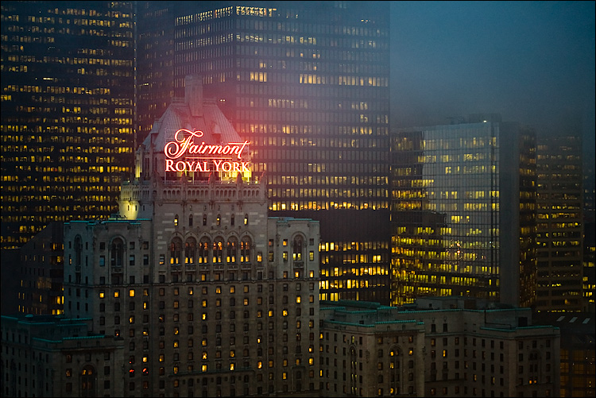
In the novel, Mindscan, the Fairmont Royal Hotel is the setting for the Immortex conference held at the beginning of the story, outlining for the main characters, Jake and Karen, as well as the readers, the Mindscan process. The hotel has gone through many renovations but maintains and revels in it’s timeless authenticity and glamour: “Although the years have brought changes [and renovations], many features are still intact”; a theme consistent with the novel which delves into our understanding and acceptance of aging.
http://www.fairmont.com/royal-york-toronto/hotelhistory/

Slide 6
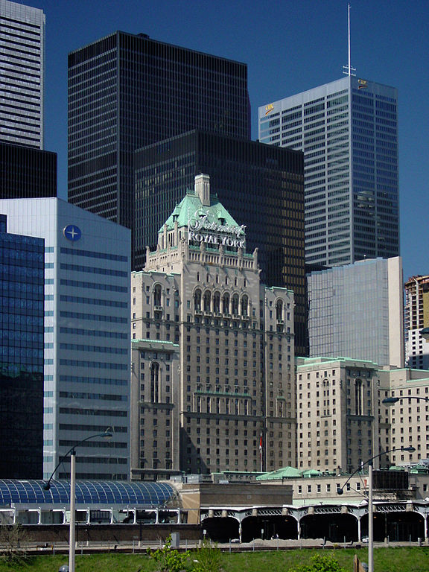
- “the magnificent hand-painted ceilings, the travertine pillars, ornate furnishings, crystal chandeliers and wall hangings”. http://www.fairmont.com/royal-york-toronto/hotelhistory/
There is an appreciation for the old and the original, yet a fascination and demand for upgrades, renovations, and processes for preservation. There is a contrast between the older façade, which itself has been upgraded and maintained, that holds its own among the steel and glass of new age architecture. The people who have chosen to become Mindscans, too, have a fascination and demand for upgrades and preservation in order to maintain the original splendour.

